Slide 1
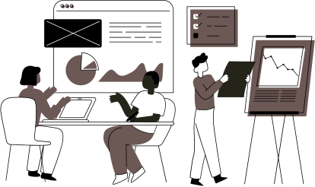
CUSTOMER CHURN PREDICTION
Presented By:
Abhinav Sharma
Amith Nadig
Aparna Verma
Ritika Pandey
Sumbul Khan

Slide 2





Our Team
Amith Nadig
Aparna Verma
Abhinav Sharma
Ritika Devendra Pandey
Sumbul Khan

Slide 3
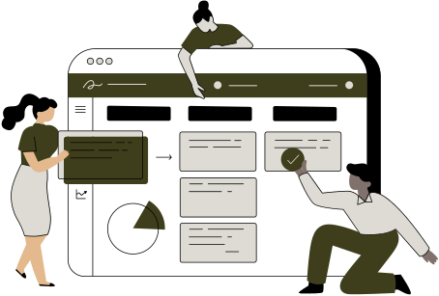
Contents
Introduction
Statement of Purpose
Scope of the Project
Data Design and Collection Methodology
Analytical Insights and Results
Strategies and Recommendations
Business Impact and Conclusion
Future Outlook

Slide 4


Introduction
In telecom, customer loyalty is crucial, but churn poses a constant threat. Our project focuses on developing a SAS-based predictive model to identify potential churners. By leveraging data analytics, we aim to empower companies with actionable insights for proactive churn management and stronger customer relationships, ensuring long-term success in a dynamic market.

Slide 5

Statement Of Purpose
Background: High churn in telecom leads to revenue loss and high acquisition costs, emphasizing the need for effective churn prediction and retention strategies.
Relevance: SAS-driven analytics and machine learning excel in understanding customer behavior and predicting churn, enabling proactive engagement and personalized offers to enhance satisfaction and loyalty.
Project Goal: Our project merges data, analyzes patterns, builds predictive models for churn-risk customers, and tailors retention strategies, adapting to changes.
Notes:
Background: The telecom industry faces fierce competition and high customer turnover, with churn posing a significant obstacle. High churn rates reduce revenue and inflate acquisition costs, highlighting the importance of predicting and addressing churn for effective retention strategies.
Relevance: Data analytics and machine learning, particularly leveraging SAS, provide unmatched solutions in understanding customer behavior and predicting churn likelihood. This empowers proactive engagement and personalized offers, enhancing customer satisfaction and loyalty
Project Goal: Our project aims to merge diverse data sources, conduct thorough exploratory analysis to uncover patterns, engineer precise predictive models to identify churn-risk customers, and translate insights into tailored retention strategies. Continuous monitoring and refinement ensure adaptability to evolving dynamics.

Slide 6

Scope of the Project
Project Boundaries:
Utilizes Customer, Internet, and Churn Datasets with Data Dictionary.
Excludes external data sources for focus and data quality control.
Employs SAS for statistical analysis and machine learning modeling.
Focuses on binary classification techniques like logistic regression.
Target Industry: The Telecommunications sector focusing on mobile, internet, and television services.
Time Frame: Analyzes historical data without real-time analysis.
SAS Language Limitation: Solely uses SAS for data preprocessing, modeling, and analysis.

Slide 7

Key Deliverables
Integrated Data Repository: Merge and document diverse data sources for analysis.
Exploratory Data Analysis Report: Uncover insights and patterns in initial data exploration.
Predictive Model: Develop a robust model to identify churn-prone customers.
Data Insights Report: Detail patterns correlating with increased churn rates.
Implementation Guide: Translate model predictions into actionable business strategies.
Strategy Recommendations: Formulate retention initiatives based on predictive model results.
Monitoring Framework: Establish regular model updates and performance evaluations.

Slide 8
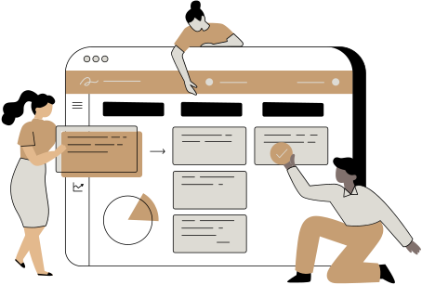
Data Design and Collection Methodology
DATA OVERVIEW
Customer Data: Foundational demographics (ID, Age, Gender, Tenure, Contract, Billing).
Internet Data: Subscription details (ID, Service Type, Charges, Data Usage, Services).
Churn Data: Churn status and reasons (Status, Date, Reasons).
DATA COLLECTION
Acquired from publicly available and internal sources.
Customer Management Systems: Demographics and churn data.
Service Usage Systems: Detailed service usage records.
Billing Systems: Billing, payment history, and financial interactions.

Slide 9

ANALYTICAL APPROACH
Data Preprocessing
Automate dataset integration using customer IDs for integrity. Streamline data manipulation to match customer behavior and churn drivers.
Feature Selection
Analyze data to find key predictors of churn. Streamline model inputs for better accuracy.
Model Development
Develop multiple predictive models (e.g., logistic regression) for robust churn prediction. Automate model training for consistency and reproducibility across systems.
Model Evaluation
Evaluate model performance with metrics and diagnostics to accurately reflect customer behavior and churn factors.
Deployment
Integrate top model for real-time churn prediction and scoring. Enable automated interventions for churn reduction and retention.
Notes:
Data Preprocessing
Integration and Automation: Merge diverse datasets seamlessly using customer IDs, ensuring data integrity and eliminating manual handling.
Efficient Data Handling: Manipulate and transform data efficiently to align attributes with customer behavior and churn drivers.
Feature Selection
Identifying Key Predictors: Analyze data to pinpoint features significantly impacting churn, focusing on frequent patterns and behaviors.
Streamlining Model Inputs: Refine selected features to enhance model relevance and accuracy in predicting churn.
Model Development
Multiple Predictive Models: Develop various models like logistic regression and decision trees for a robust churn prediction approach.
Automated Model Training: Automate the entire modeling process for consistency and reproducibility across systems.
Model Evaluation
Performance Metrics: Systematically evaluate model performance using accuracy, sensitivity, and specificity metrics, along with diagnostic plots and statistical tests.
Enhanced Diagnostics: Refine models using advanced diagnostics to accurately reflect customer behavior and churn factors.
Deployment
Operational Integration: Integrate the best-performing model into operational systems for real-time scoring and prediction of potential churners.
Scoring: Utilize automated scoring systems to predict churn and enable timely interventions, supporting churn reduction and customer retention strategies.

Slide 10
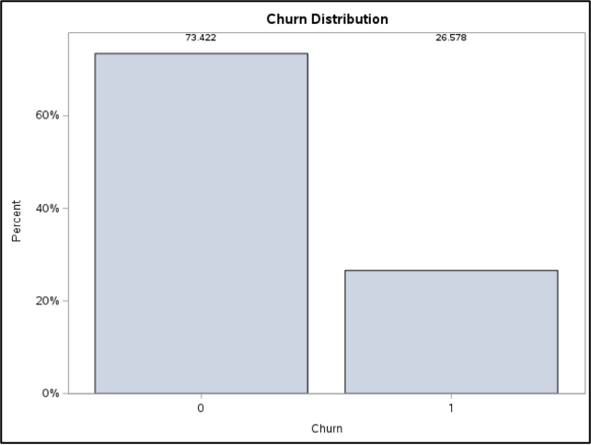
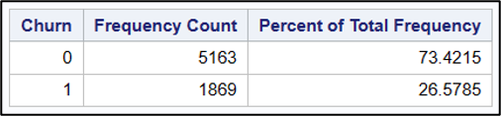
Analytical Insights and Results
The current retention rate of the telecommunication company is 73.4%, showing effective customer management strategies. Yet, there are opportunities for targeted improvements to reduce churn and boost satisfaction.

Slide 11
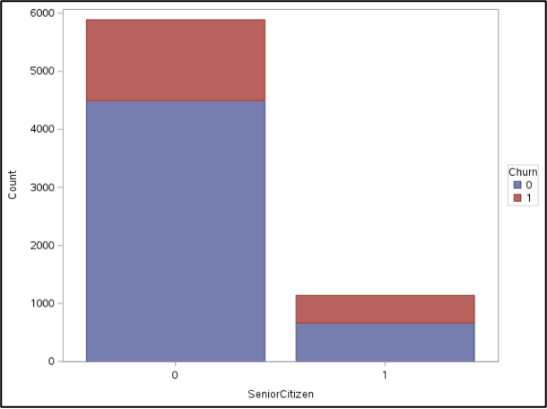
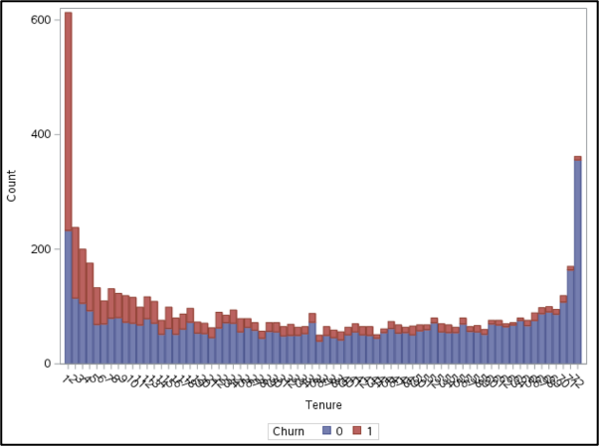
Strategic Analysis of Customer Retention Factors
High churn among senior citizens calls for senior-friendly services. Month-to-month contracts have a 70% churn rate; promote longer-term commitments with incentives.
Notes:
Senior Citizens: High churn rate suggests a need for senior-friendly services and communication strategies.
Contract Type: Month-to-month contracts exhibit a 70% churn rate, highlighting a need for promoting longer-term commitments. Offer incentives for one-year and two-year contracts to reduce churn rates and enhance customer value perception.

Slide 12
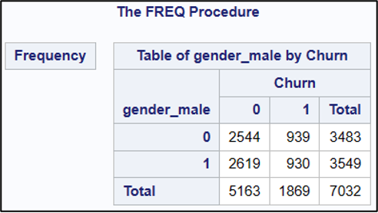
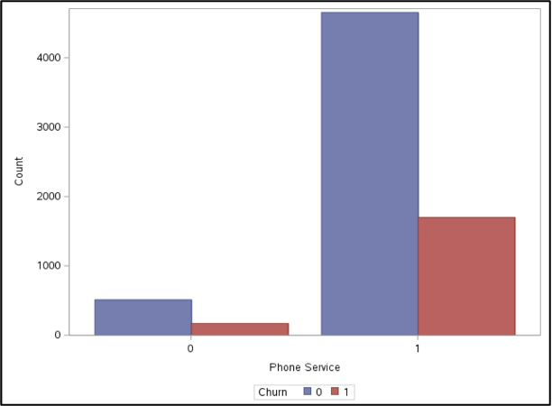
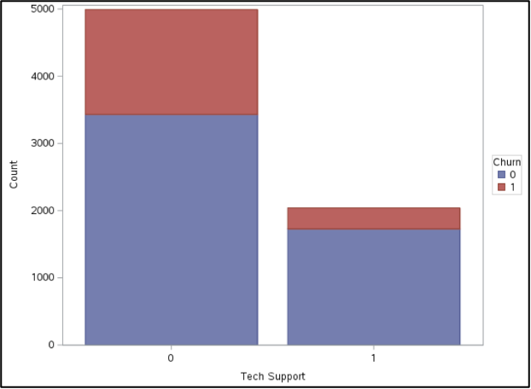
Service Features: Make online security, device protection, and tech support standard in premium plans.
Gender Dynamics: Churn rates are similar across genders, indicating a need for gender-neutral retention strategies.
Phone Service: High retention acts as a loyalty anchor, deterring churn due to inconvenience.

Slide 13
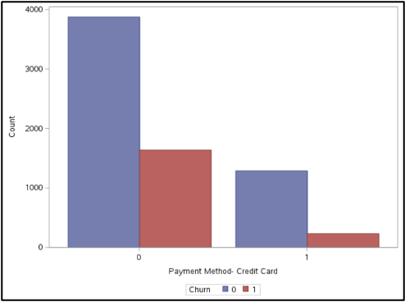
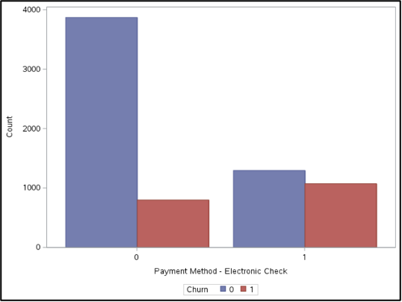
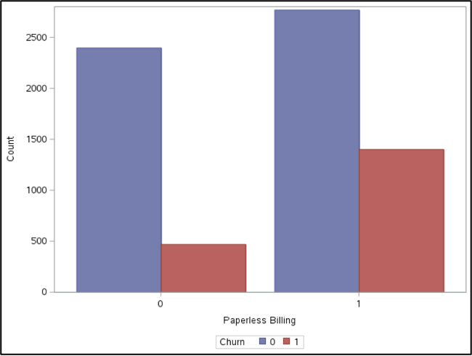
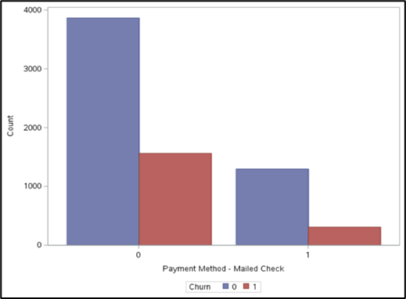
Payment Methods & Customer Churn
Payment method is critical to customer satisfaction and retention—strategies to improve payment experiences can reduce churn.
Notes:
Paperless Billing: Not reducing churn as expected. Customers using this service show higher churn rates, possibly indicating a preference for superior digital experiences or online offers from competitors.
Credit Card Users: Display loyalty, yet exhibit a notable churn segment. Review and address underlying dissatisfaction.
Electronic Checks: High churn rate suggests dissatisfaction with the payment process. Investigate and improve the user experience.
Mailed Checks: Moderate loyalty; potential for improvement by simplifying the payment process and offering incentives.
Payment method is critical to customer satisfaction and retention—strategies to improve payment experiences can reduce churn.

Slide 14

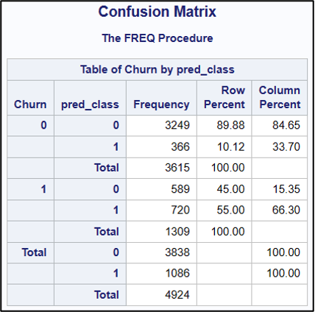
Rigorous testing and validation of Model 1 with a dataset of 4924 customers.
Model 1 achieves an impressive 84.5% concordance rate.
Accurate prediction of churn 55% of the time.
Key insights:
Tenure: Longer engagement correlates with lower churn rates, emphasizing the importance of cultivating lasting relationships.
Contract Duration: Longer contracts result in lower churn, indicating the value of promoting commitment.
Payment Method: Reliance on electronic checks is associated with higher churn, highlighting the need for contactless payment mechanisms.
These insights provide strategic direction for enhancing customer retention and fostering loyalty.

Slide 15
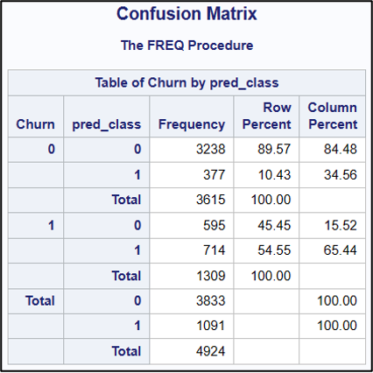
Model 2 improves interpretability by addressing multicollinearity.
Strong performance with over 89% accuracy in predicting non-churn cases.
Variance Inflation Factor (VIF) Analysis refines predictive capabilities by eliminating variables with elevated VIF scores.
Critical factors such as tenure, contract duration, and payment method remain significant predictors of churn.
Observation of senior demographics consistently churning suggests an opportunity for targeted retention strategies tailored to their needs.
This targeted approach, grounded in rigorous analysis, positions the company to proactively reduce churn and enhance customer loyalty.

Slide 16
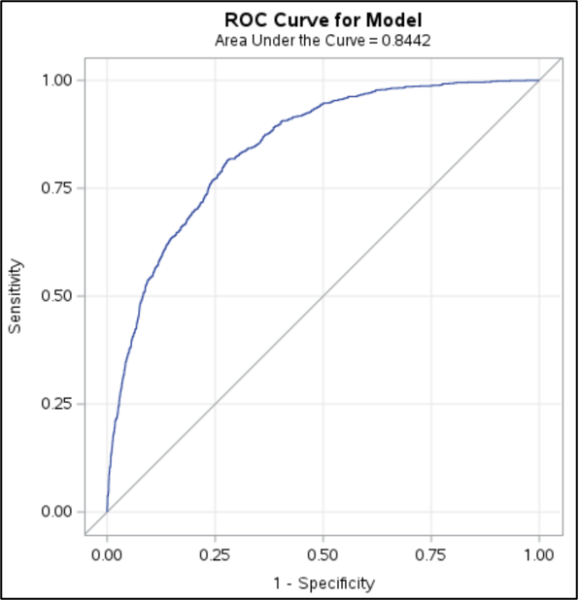
Model 2 demonstrates a strong performance with an AUC of 0.8442. The ROC curve illustrates an initial steep ascent, indicating heightened sensitivity in identifying true churn risks, while effectively sparing innocent non-churners. Its arc gracefully bows towards the upper left quadrant, reflecting performance excellence in capturing true positives. Through the ROC curve, it is clear that our model performs a lot better than a random classifier.

Slide 17

Strategies and Recommendations
Enhanced Customer Profiling
and Segmentation
Improved Service Quality
and Customer Support
Flexible Contractual
Options and Incentives
Optimized Payment
Methods
Integration of AI and ML for
Dynamic Retention Strategies
Utilizing Behavioral Economics for Enhanced Customer Engagement

Slide 18

Conclusion
This project tackles the persistent issue of customer churn in the telecommunications industry by using advanced data analytics and predictive modeling. It not only predicts churn but also provides actionable strategies to retain customers and enhance satisfaction. By leveraging deep insights into customer behavior, the project enables timely interventions, ensuring lasting success in a competitive market. Embracing innovative solutions marks a significant step in understanding and addressing churn, fostering resilient customer relationships and a competitive edge.

Slide 19

Future Outlook
Cultivate a culture of continuous improvement in customer data analytics.
Invest in and enhance data infrastructure and analytics capabilities.
Align with technological advancements and evolving customer expectations.
Adopt a proactive approach to customer relationship management.
Deepen customer relationships through personalized interactions and service offerings.
Embed customer-centric values across all levels of the organization.
Prioritize strategies and operations to enhance customer satisfaction and loyalty.
Cultivate a more resilient and customer-focused business model.
Ensure competitive standing in a dynamic industry landscape.

Slide 20

Thank you !
Kindly do let us know if we can answer any questions that you might have about the project.

